Slide 1
BUS TICKET RESERVATION SYSTEM
Name : M.MAUL SRI
Date Submitted:17/10/2024

Slide 2
AIM
To achieve user friendly bus booking system.
Integrating booking functionalities for user comfort.
To reduce bother associated with travel journey.
More convenient experience than visiting counter.

Slide 3
PROBLEM STATEMENT
Strightforward booking process and guiding users in a clear manner.
By handling errors and exception it bring satisfaction.
Allow the passenger to check seat availability and make reservation.
A complex interface can deter users so simplifying the booking process is essential.

Slide 4
PROJECT DESCRIPTION
The code contain method overriding, class inheritance and file handling.
User can quickly find information about their accurate bus schedule.
If the seats are available, user can receive confirmation.
It allows passengers to search for, reserve and purchase bus tickets online.

Slide 5
FUNCTIONALITIES
View Bus Information:
Allow users to easily access bus information in clear and concise manner.
Checking seats availability:
Determine whether the desired number of seats are available.
Booking seats:
Passenger name: The name of the individual travelling.
Seat preference: Sleeper with AC or Non-AC.

Slide 6
FUNCTIONALITIES (Contd..)
Slot number : Morning or evening they want to reserve.
Travel Date: On which date they intend to travel.
Receive confirmation:
The system generates a confirmation message when booking is successfully completed.
Error Handling:
It includes mechanism for handling invalid inputs such as incorrect date format and seat availability.

Slide 7
INPUT VERSATILITY WITH ERROR AND EXCEPTION HANDLING
Managing file operation.
Prompt the user to enter specified format.
Try and except block offers user to easily recover from errors.
Example:
If the requested number of seats exceed available seats, then
it alerts the user with message.
Incase user entered a past date, this system guide the user in
right direction.

Slide 8
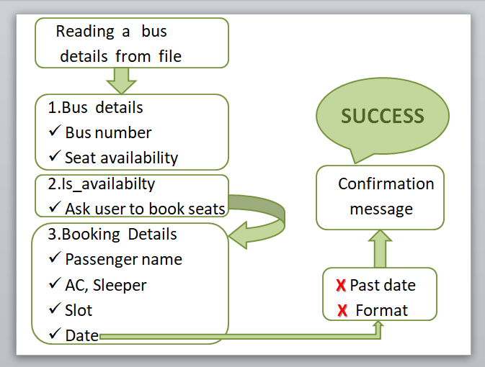
CODE IMPLEMENTATION

Slide 9
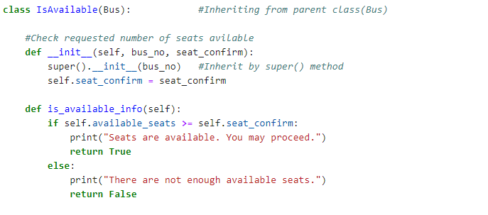
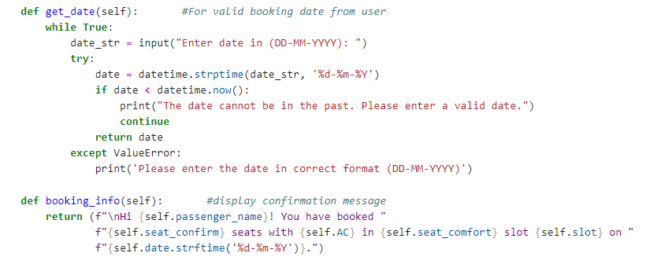
CODE SNIPPET:

Slide 10
RESULTS AND OUTCOMES
We achieved a user-friendly bus booking system
that checks
seat availability
facilitates reservations
error handling and input validation.
Ensures that users receive immediate response.
Error handling for file access issue enhances reliability.

Slide 11
CONCLUSION
Essential tool for enhancing travel efficiency and convenience for passengers.
This system potrays the seamless and efficient approach for travel.
Commitment to enhancing customer satisfaction.
It allows passengers to secure their seats in advance, especially during peak travel times.

Slide 12
THANK YOU

